Slide 1

TICAP Assistant
Threat Intelligence Correlation & Alert Prioritisation — Ingesting multi-source feeds, correlating genuine threats, mapping MITRE ATT&CK, and delivering commander-ready BLUF summaries in seconds.
Security analysts receive over 10,000 alerts daily across SIEMs, sensors, satellite feeds, and intel reports. Finding a critical APT activity in this stack isn't just hard — it's humanly impossible.
Presented by Team Bob | 5-Minute Pitch

Slide 2









Why Traditional SOC Tools Fail
Data Silos & Format Friction
Crushing Alert Fatigue
Slow Executive Reporting
Legacy SIEMs handle syslog and standard JSON formats well, but systematically fail to ingest un-structured satellite telemetry (CSV) and raw intelligence reports (TXT) into a unified context.
Rule-based triage systems generate up to 98.8% false positives. Genuine multi-stage APT attacks get drowned out in noise queues, leading directly to analyst burnout and overlooked breaches.
Converting millions of raw telemetry logs into structured Bottom Line Up Front (BLUF) briefings for commanders manually takes analysts 2 to 4 hours per security incident.

Slide 3

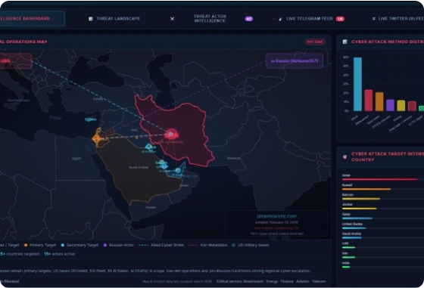
Our Solution — The TICAP Platform
Unified Multi-Source Correlation: Seamlessly ingests disparate feeds (SIEM, Satellite Telemetry, Cyber Sensors, Threat Intel) into a single graph-correlated engine.
Instant False-Positive Filtering: Reduces alert noise by up to 98.8%, auto-isolating high-confidence threats (>85% confidence score) for immediate triage.
Automated Commander BLUF Generation: Transforms millions of raw telemetry events into structured, executive-level military-grade briefings in under 3 seconds.

Slide 4
Core Modules & Engine Breakdown
Multi-Source Feed Ingestor: Simultaneously ingests SIEM JSON, Satellite CSV, Cyber Sensor CEF, and Intel TXT files with built-in PII masking and automatic JSON normalization.
Multi-Layer Correlation Engine: Links isolated telemetry events (IPs, hashes, satellite GPS anomalies) into unified threat clusters using cross-feed graph clustering.
Automated MITRE ATT&CK Mapping: Scans payload signatures and command structures against MITRE v15 definitions to auto-highlight kill-chain stages (e.g., T1003.001, T1498).
Instant BLUF Report Generator: Synthesizes correlated alert clusters into standardized military-grade executive briefings complete with threat level, asset impact, and prioritized actions.
Analyst Command Bar & Live Triage: Reactive UI allowing analysts to execute CLI queries (/threat-run, /mitre T1059) with real-time severity and health updates.

Slide 5

What Makes TICAP Unbeatable?
Cross-Domain Integration: The only triage assistant designed to correlate defense-grade satellite telemetry anomalies with enterprise endpoint SIEM logs.
Zero-Latency BLUF Synthesis: Reduces Commander briefing preparation time from 3 hours down to 3 seconds.
Integrated Command Interface: Combines interactive graph visualization with analyst CLI capabilities for high-velocity operations.
Proven Noise Reduction: Cuts through 4,800+ raw feeds down to 23 genuine actionable threats (98.8% reduction).

Slide 6






Addressing a $300B+ Cyber Imperative
TAM (2026 Target)
SAM
Mil / Gov Defense
Global SIEM & Threat Intelligence Market
Defense & Aerospace SOC Market Segment
Aerospace Operations & Mission-Critical OT
Key Market Drivers: Rapid expansion in commercial/military satellite constellations, escalating nation-state APT campaigns, and a severe global shortage of qualified cybersecurity analysts.

Slide 7


Scalable SaaS & Defense Licensing
Tiered Subscriptions
Add-Ons & Services
Tier 1 — SOC Essential: Standard SIEM and cyber sensor feed correlation for enterprise security operations.
API Volume Add-Ons: Flexible usage-based pricing tiers for ultra-high-velocity sensor streams (>1M events/day).
Tier 2 — Defense & Orbital: Full satellite telemetry ingestion, automated Commander BLUF module, and air-gapped on-premise deployment options.
Professional Services: Custom connector engineering for proprietary military satellite telemetry protocols and legacy defense SIEMs.

Slide 8




90-Second Demo Walkthrough Flow
0:20 - 0:40 | Step 2
1:00 - 1:30 | Step 4
Correlation: Display 98.8% noise filtration. Drill down into CRIT-001 (APT-41 credential dumping).
BLUF Output: Open BLUF Reports tab. Display generated executive briefing ready for commander sign-off.
0:00 - 0:20 | Step 1
0:40 - 1:00 | Step 3
Ingestion: Feed ingestor receives 4,827 raw alerts across SIEM, Satellite & Intel. Execute /threat-run.
MITRE Mapping: Navigate to MITRE Matrix tab. Click T1003.001 to view full kill-chain attribution.

Slide 9









Technical Roadmap & Future Scope
Q4 2026 — SOAR Playbooks
Q1 2027 — Air-Gapped LLM
Q2 2027 — Predictive RL
Autonomous Playbook Execution via SOAR integration for automated firewall rules, endpoint isolation, and instant satellite payload lock-down.
Air-Gapped LLM Integration enabling natural language threat hunting and automated BLUF translation into multi-lingual NATO formats.
Predictive Attack Path Forecasting using reinforcement learning models trained on historical MITRE ATT&CK adversary tactics.

Slide 10
TICAP Platform
Command Clarity at the Speed of Threat
4,827 Raw Feeds
TICAP Engine
1 Commander Decision
team@ticap-defense.io github.com/ticap-defense

Slide 11


Image Sources
https://stackcyber.com/img/posts/cyber-dashboard-750w.jpg
Source: stackcyber.com
https://www.iiss.org/globalassets/media-library---content--migration/images-delta/comment/analysis/2025/may/oa_27052025_.png
Source: www.iiss.org

